Slide 1
TensorFlow Computer Theory
-Summary
-Summary
-Summary
Jack Wu

Slide 2
Part 1: Processor
In this part, we will discuss the supported hardware by TensorFlow.

Slide 3
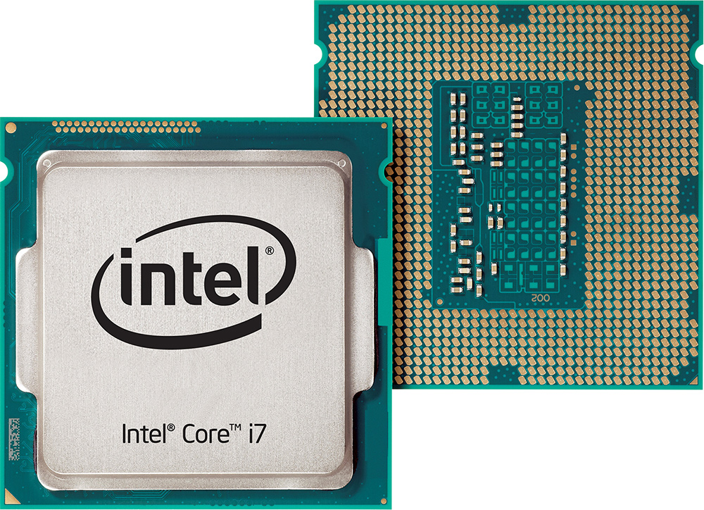
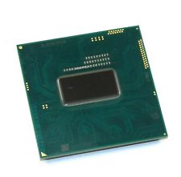
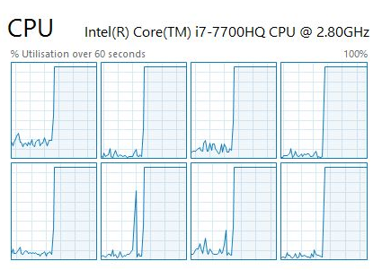
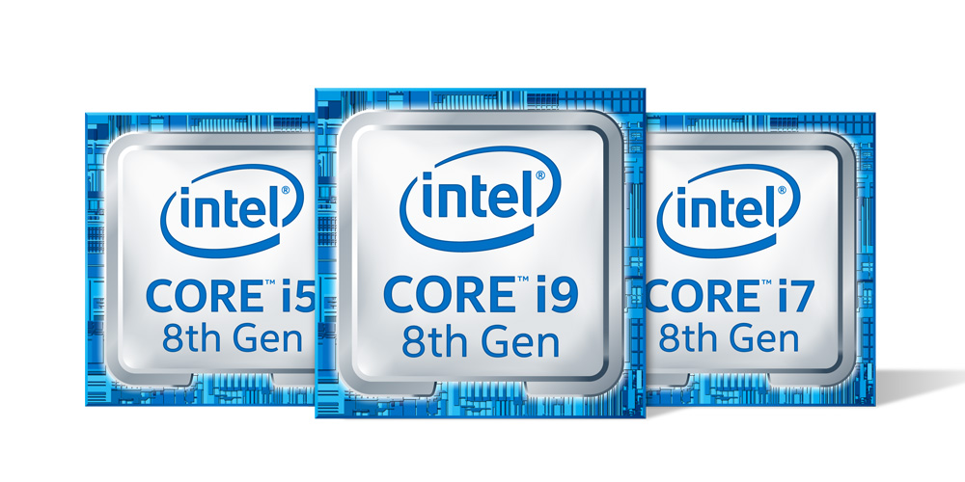
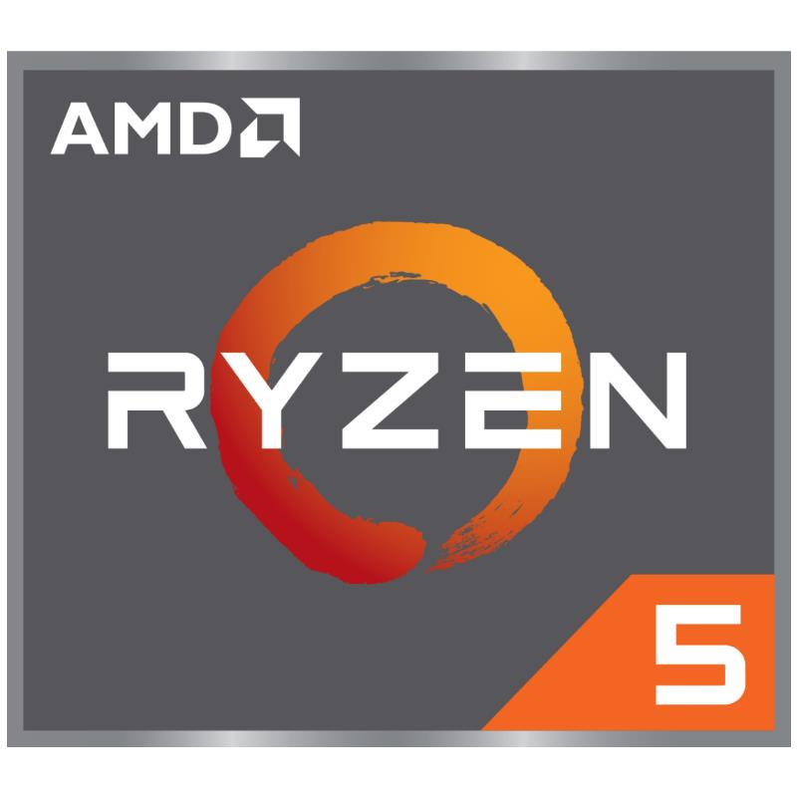
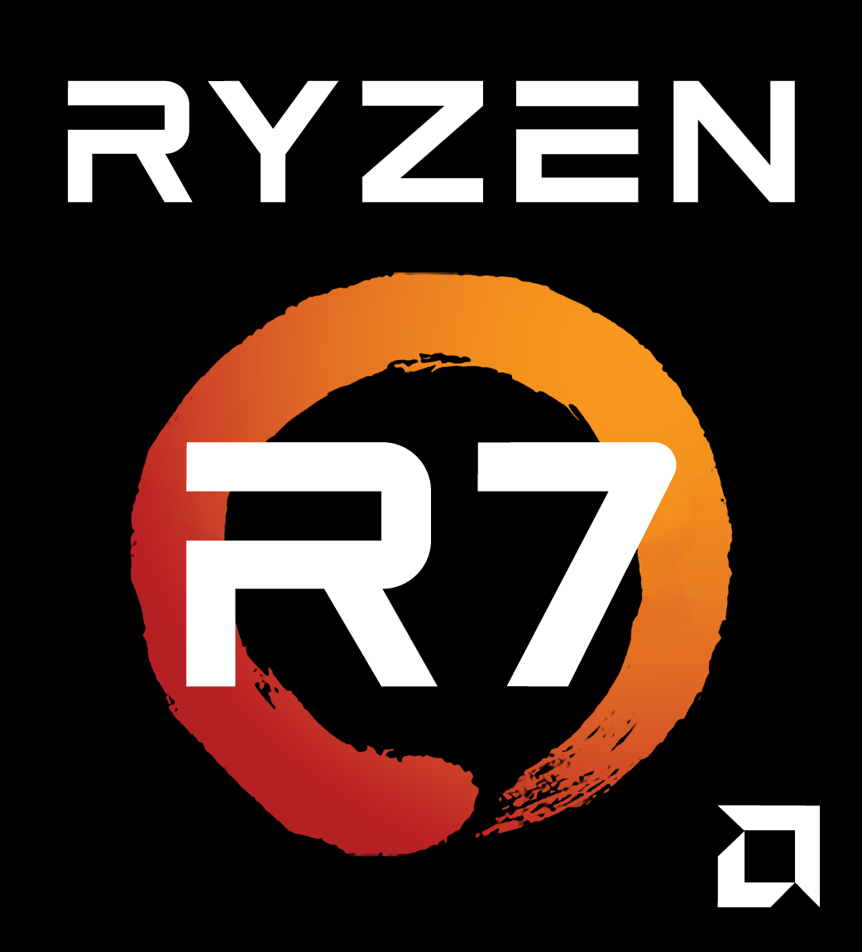
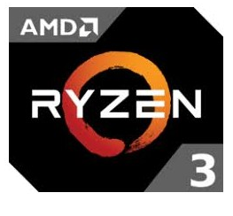
CPU The computer used to record this course uses an intel i7-7700HQ CPU.
Top: Desktop CPU / Mobile CPU.
Bottom: CPU Status in Task Manager.
CPU stands for Central Processing Unit.
Every computer has a CPU. It is like the heart of a human.
Two of the most famous CPU makers are intel and AMD.
You might have a intel Core i7 or a AMD Ryzen R7 in your computer!
CPU has several computing ‘Cores’. Each core process one task at one time. Some CPU has ‘Hyper-threading Technology’ so one core can run multiple threads of task in the same time.
Core 1
Thread 1
Core 1
Thread 2
Core 2
Thread 1
Core 2
Thread 2
Core 3
Thread 1
Core 3
Thread 2
Core 4
Thread 1
Core 4
Thread 2
Read More: Hyperthreading (https://en.wikipedia.org/wiki/Hyper-threading)

Slide 4
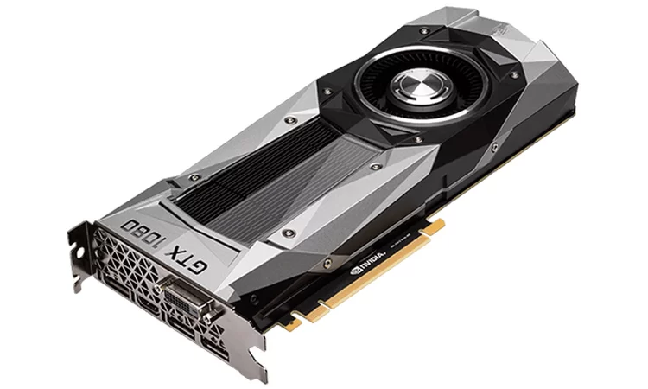
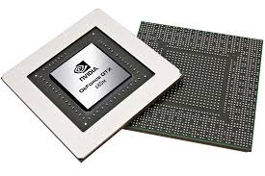
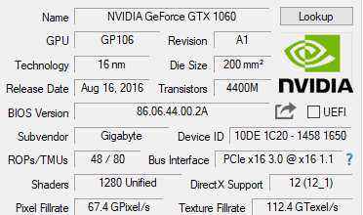
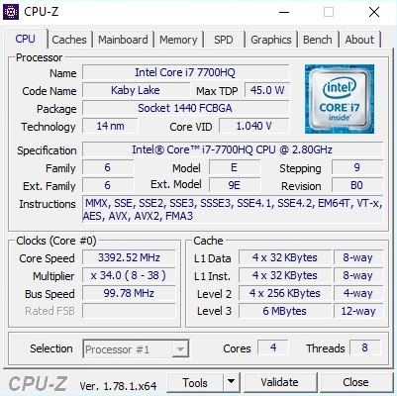
GPU The computer used to record this course uses a NVIDIA GeForce GTX 1060 GPU.
GPU stands for Graphic Processing Unit.
Mostly for gaming, but you can also train ML models with it!
It has thousands of small computing units, and runs thousands of tasks simultaneously. Therefore MUCH more efficient than CPU. (e.g. 1280 GPU CUDA Cores vs. 4 CPU Cores)
Two most famous GPU makers: NVIDIA and AMD.
NVIDIA: GeForce(Consumer), Quadro(Professional), Tesla(Accelerator)
AMD: Radeon(Consumer), Radeon Pro(Professional)
Up: Spec for GPU
Down: Spec for CPU

Slide 5
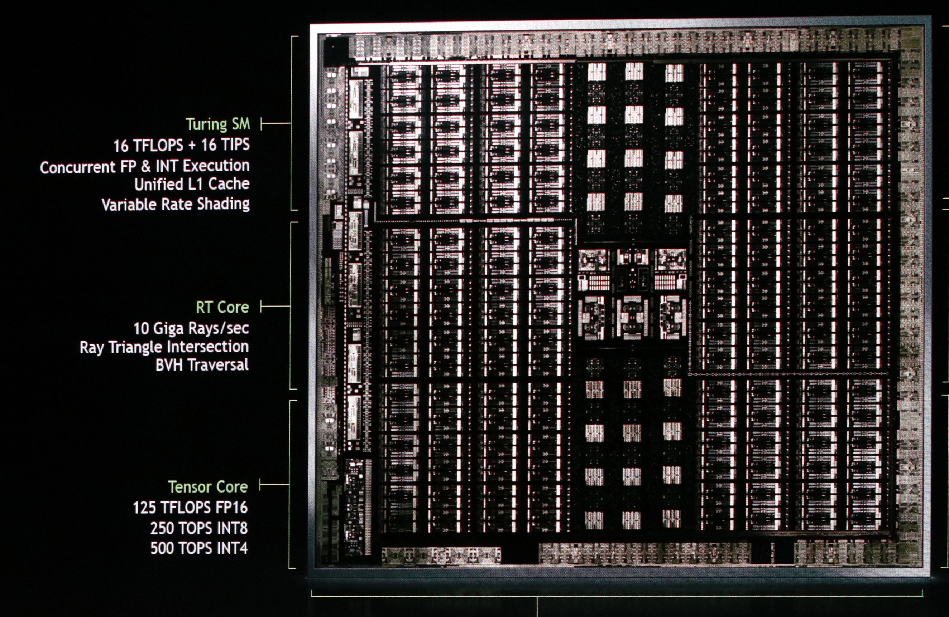
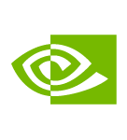
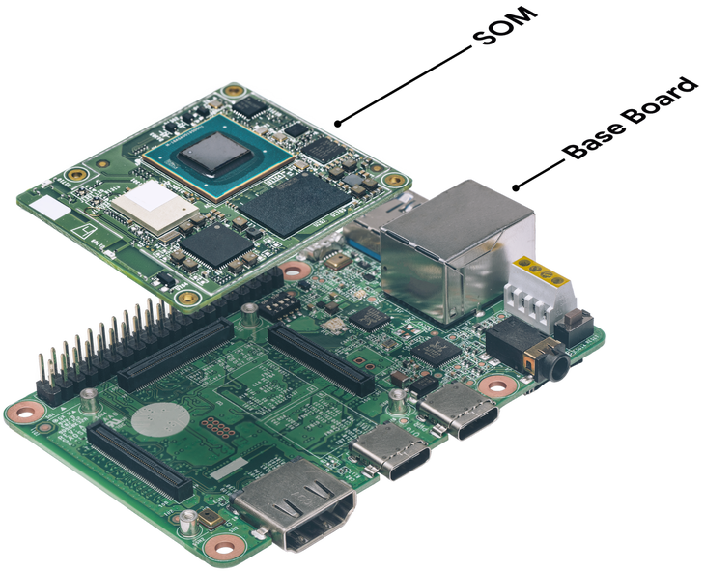
TPU
TPU stands for Tensor Processing Unit.
Google developed TPU specifically for AI Training.
NVIDIA also put “Tensor Cores” into their newest Turing and Volta architecture GPU.
Top: NVIDIA “Turing” GPU
Bottom: A Google TPU.
Image Credit: https://techcrunch.com/2018/07/25/google-is-making-a-fast-specialized-tpu-chip-for-edge-devices-and-a-suite-of-services-to-support-it/

Slide 6
Processor TensorFlow runs on three type of processors: CPU, GPU, and TPU.
TensorFlow can run on a Central Processing Unit(CPU) that every computer has for central calculating operation.
GPU stands for Graphic Processing Unit. GPU has a lot of small computing cores, and can boost up the training speed by running them simultaneously in every small core.
TPU stands for Tensor Processing Unit, which is a chip Google developed specifically for Machine Learning. However, the new NVIDIA Turing and Volta GPU cards also have ‘Tensor Core’ for tensor computing.

Slide 7
Part 2: Platform: Personal Computing
In this part we will talk about the software platforms that TensorFlow runs on.

Slide 8
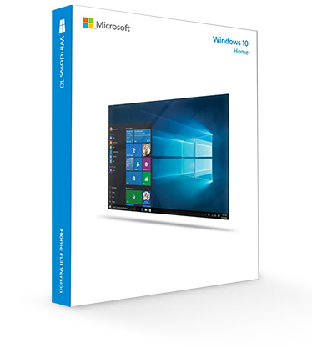
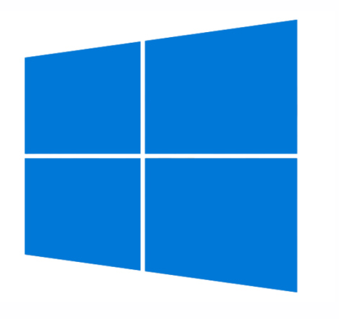
Windows
Windows is the most used operating system in the world!
It is also the easiest OS for beginners comparing to Linux.
According to a Stack Overflow "Web Developer Survey Results 2018" survey, 49.4% developers use Windows as their work operating system[1].
This course is recorded using Windows 10!
[1]: https://insights.stackoverflow.com/survey/2018/#development-environments-and-tools

Slide 9
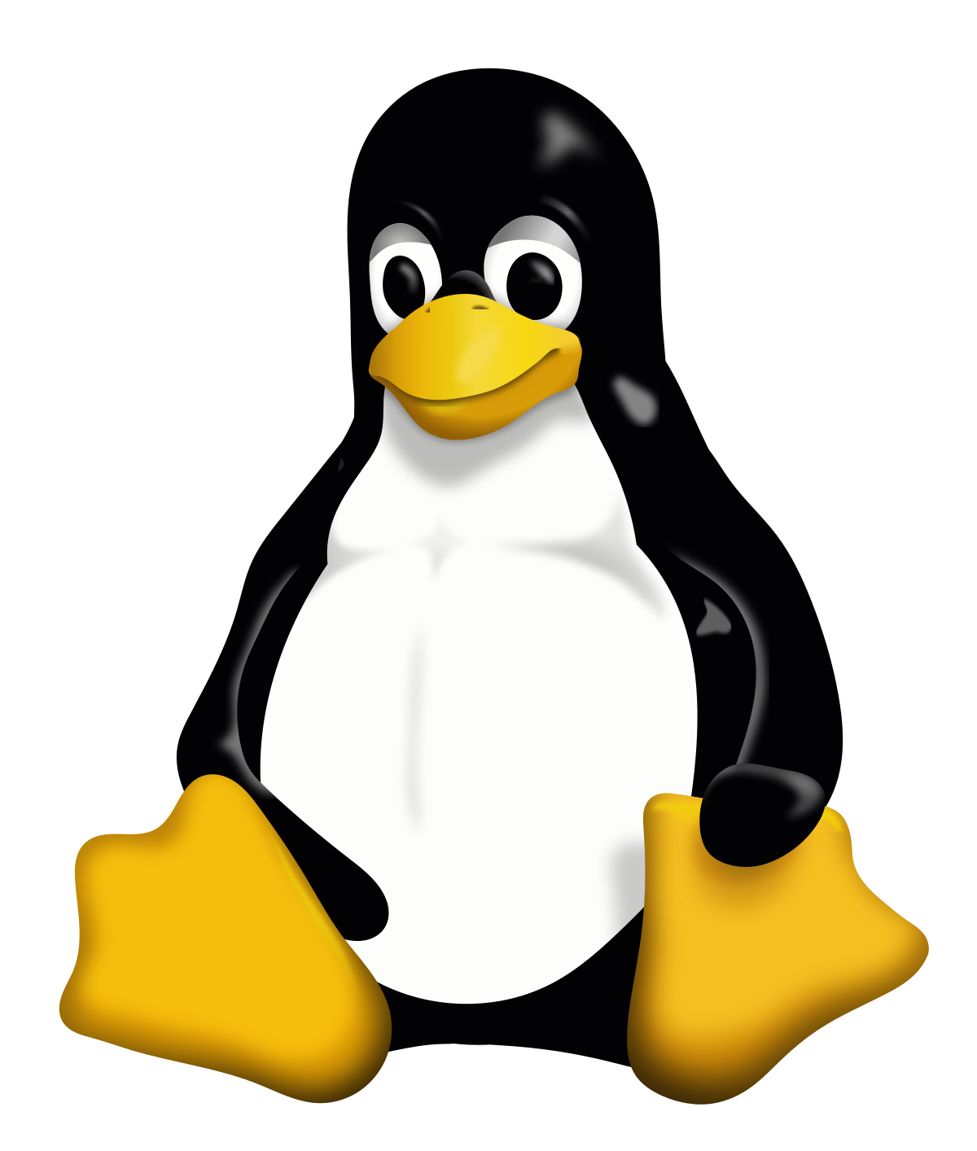


Linux / macOS
Linux has many distributions sharing the same Linux kernel, and the most popular one is Ubuntu. There are also others: centOS, Arch, Fedora,
macOS, along with many Linux distributions, uses a kernel (Unix) that is similar to the one used in Linux distributions.
About 27.4% developers use macOS, and about 23.0% developers use Linux.[1]

Slide 10
Platform: Personal Computing
Windows:
The most used operating system for humans these days.
TensorFlow runs on Windows with a Python environment. This is the platform that this course will be recorded in.
Linux:
Natively supports Python, so TensorFlow runs on all distributions of Linux.
Linux has many distribution versions, but they all are based on the same kernel. The most popular distribution is Ubuntu.
macOS:
macOS uses Unix as its kernel, which is similar to Linux.
Therefore, macOS users will have a similar user experience with those who uses Linux.

Slide 11
Part 3: Platform: Mobile
In this part we will talk about the software platforms that TensorFlow runs on.

Slide 12
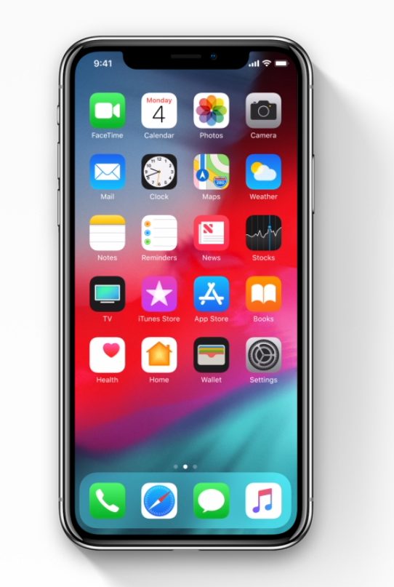
iOS
TensorFlow can also run in iOS.
Apple now have 1.3 Billion devices running iOS, and there are 2 million apps in the APP Store.[1]
iOS not only allow apps run on iPhone, but also iPad and iPod!
[1]: https://www.macrumors.com/2018/02/01/apple-now-has-1-3-billion-active-devices-worldwide/

Slide 13

Android
Google also developed Android, so Tensorflow is well supported by Android.
There are over 2 Billion Android devices around the world and over 3 million Android APP! [1]
Mobile computing power are getting better and better every year, many mobile chip companies like Snapdragon also added in AI processing unit into their mobile chips.
[1]: https://www.theverge.com/2017/5/17/15654454/android-reaches-2-billion-monthly-active-users

Slide 14
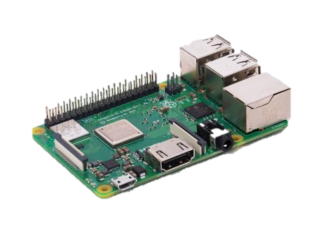
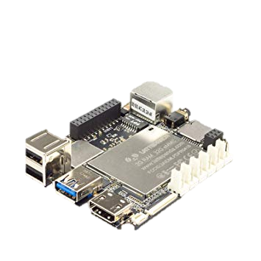
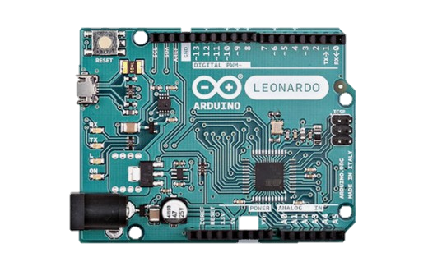
Single-Chip Microcomputers
A Raspberry Pi board that runs Linux based Raspbian OS.
Probably the most famous single chip microcomputers is the Raspberry Pi.
Raspberry Pi runs on Raspbian, which is an OS based on Linux —— so it is supported!
Some others use Windows as OS, like LattePanda, which is also supported.
TensorFlow cannot run on Arduino.
A LattePanda board that runs Windows 10.
An Arduino board.

Slide 15
Platform: Mobile
iOS:
TensorFlow is supported on iOS. There are millions of iOS devices in the world now.
Building TensorFlow on iOS Documents: https://www.tensorflow.org/mobile/ios_build
Android:
Since Google developed Android, TensorFlow also runs on Android
By implementing machine learning to mobile devices we can make machine learning more accessible and friendly to humans.
Single-chip Microcomputer:
They all run on a Linux or Windows based operating system, so they are supported as well!
Arduino is not supported.

Slide 16
Part 4: Cloud Computing (Optional)
In this part we will talk about Cloud Computing.

Slide 17
TensorFlow Distributed Execution Engine
In machine learning, the most time consuming process is training the model. Therefore, the TensorFlow Distributed Execution Engine is able to distribute task to many, sometimes hundreds and thousands of machines to boost up the training speed.

Slide 18

Amazon AWS
Amazon AWS stands for Amazon Web Services, which “offers reliable, scalable, and inexpensive cloud computing services. Free to join, pay only for what you use.”
Data scientists in the industry usually find it useful to buy some resources on AWS when they have massive data to train a complicated model.
URL: https://aws.amazon.com/

Slide 19
Part 5: Language
In this part we will talk about computer programming languages in TensorFlow.

Slide 20

Language
Python supports many programming languages, two of the most famous ones is Python and C++.
But the support for Python is the best among other languages. There are massive Python based data science packages (e.g. pandas, numpy).
Python is the best programming language when implementing machine learning algorisms and scientific calculations.

Slide 21
Part 6: Application Programming Interface
In this part we will talk about TensorFlow API.

Slide 22
API
API stands for Application Programming Interface, and it is a set of routines, protocols, and tools for building software applications.
“Building House Metaphor”

Slide 23
Building House Metaphor
Imagine you need to build a house.
You can either build the house using the existing building bricks in the market, or use clay to burn your own bricks and then build a house using that.
Think of API as the building materials (Bricks & Clay).

Slide 24
TensorFlow as Clay
In the metaphor, TensorFlow acts like “clay”. The user must design every single detail of their model.
Pro: The user has absolute freedom and control over the model, and the model can be highly customized.
Con: Time consuming. Need to write a lot of code.

Slide 25
Keras as Brick
Many entrepreneurs already made their bricks for us! So there is no need to write that a lot of code. These API include Keras, TF-Learn, TF-Layer, etc. We will use Keras for this course.
Pro: Save time. Less effort to achieve the same result. Code is much easier to read by humans.
Con: Not as flexible comparing to customize every single detail.

Slide 26
END

